Slide 1
FOR SALE
18’-0 RACE ROCKS HT
ON ROAD RUNNER TRAILER
CALL or EMAIL FOR PRICING
TEL: 250-642-5300 ext. 103
info@silverstreakboats.com

Slide 2
18’-0 RACE ROCKS HT
Go fishing in style on this Race Rocks Hard Top!
The sidesteps make it easy to get in and out. Interior and cockpit lights for the early morning starts. Comfy swivel seats and cushions for the chilly days. Crab traps are easily stored in the self-bailing recessed bow compartment.
Add a chartplotter, downriggers, power & controls, give it all a twirl, and this boat is raring to go!
Standard Features
3/16" (5086) 6'-0" bottom with a 16° deadrise & full reverse chine
1/8" (5052) 30" sides with press bent stiffeners
Fully welded hard-top with 2-piece aluminum-framed aft-leaning windshield & (2) aluminum-framed sliding side windows
6-way fused switch panel on dashboard
8" welded aluminum cleats (x5)
Battery - single SRM 24 battery including wiring, breaker & box
Bow railing - low profile
Bow storage (open with sill)
Bilge pump - 500 GPH pump – automatic
Brackets for transducer & sacrificial anode (aluminum anode)
Chines & gunnels fully welded
Cup holders (x2)
Downrigger bracket pad mounts (welded) (x2)
Drain plugs (x3)
Electric wiper - heavy duty wiper with self-park & switch (driver)
External motor bracket for single 25" shaft engine with auxiliary mount and full width platform
Fish box in rear gunnel with cutting board
Flotation - closed cell polyurethane spray foam under decks & gunnels
Fuel tank (20 Imp Gal/90 L/24 US Gal) w/ fuel gauge - built in under deck, with filter
Fully welded aluminum cockpit deck with inspection hatches for fuel connections and wire ways
Glove box
Handrails - cabin top
Heavy duty custom hull graphic
Navigation lights (LED)
Non-skid paint on bow & main deck
Passenger grab rail
Side storage trays - full length
Steering - Single engine - single station – rotary
Storage bench seats (vented) (30"x14"x14"), x2
Swivel seats - vinyl upholstered folding swivel seat on solid pedestal (x2)
Welded bow & transom eyes with stainless steel inserts
Structural Options
Bow railing - tapered, 10" at front (closed), 6“ towards window - upgrade
Keel guard on hull bottom
Self-bailing recessed bow compartment
Side steps - fixed/welded to rod tray (side gunnel) (x2)
Canvas, Seating & Upholstery
Bench seat cushions & backrests (x2)
Cover (canvas) for battery storage compartment
Drop curtain
Pedestal upgrade to Back-Saver pedestals (x2)
Seat upgrade to Barry Marine vinyl-upholstered seat (S) x 2
Dash mat - anti-slip, black (per sq ft)
Electrical & Lighting Options
12 V power socket with USB port & LED light
Horn - single compact (stainless steel)
Light - (red & white dome-style) in cabin, vee berth or head
Light - cockpit light (LED) in welded housing
Scotty electric receptacles (x2)
Wiper - (passenger) heavy duty self-parking electric wiper with switch
Navigational & Electronic Options
Compass - surface mount
VHF - Standard Horizon GX1400GB with GPS, DSC incl. stainless steel mount & antenna (GPS ability requires external GPS)
Paint & Decal Options
Non skid strips on gunnels
Shark Hide clear coat protection on hull sides and transom
Zolatone paint with clear coat on hard top interior, cockpit & exterior (Greystone)
Trailer
Make: Roadrunner Model: #2500 Single axle, bunk trailer, with disc brakes, LED lights, and Loading guides – vertical goal post style
Power & Steering Options:
YAMAHA OR MERCURY
(Limited availability)
Chartplotters available.
Transom-mounted swim ladders available.
E&OE
For the month of June 2023 only, with the purchase of one of these Race Rocks (#1368, 1369, 1370, or 1372), we’ll throw in the net holder and a pair of bolt on rod holders for free!
Call us today! TEL: 250-642-5300 ext 103
Email: info@silverstreakboats.com

Slide 3
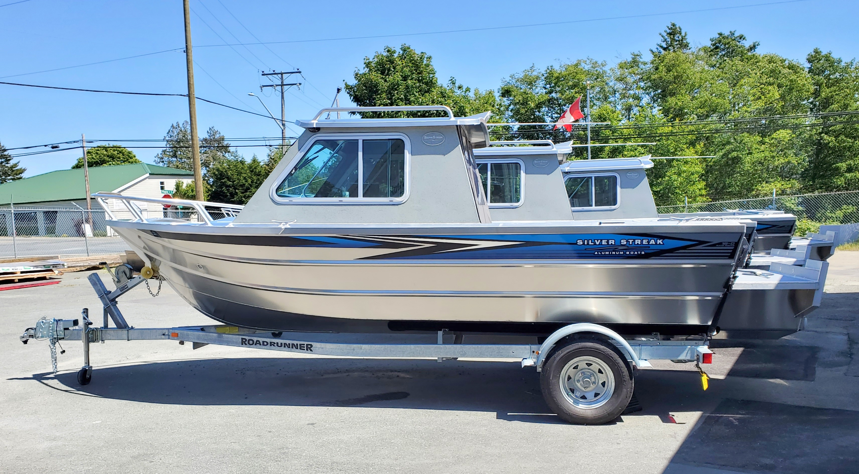
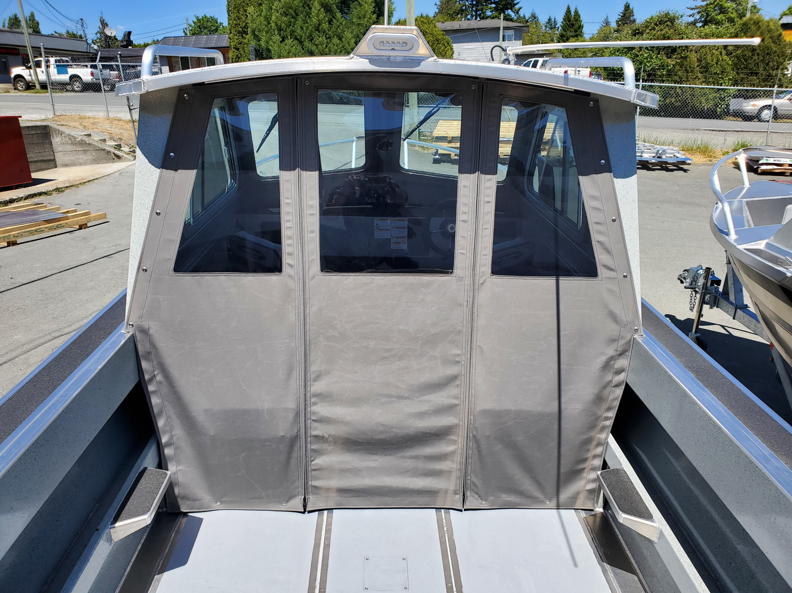
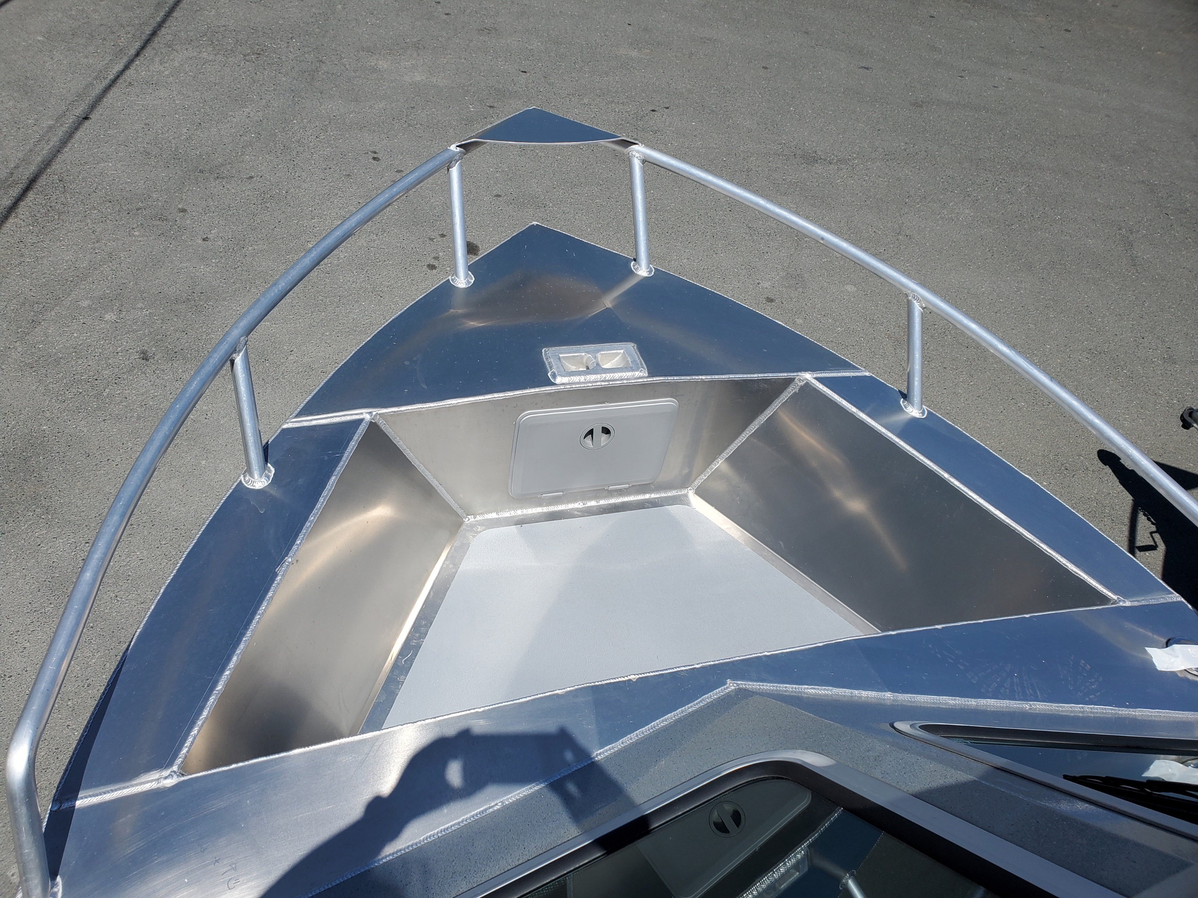
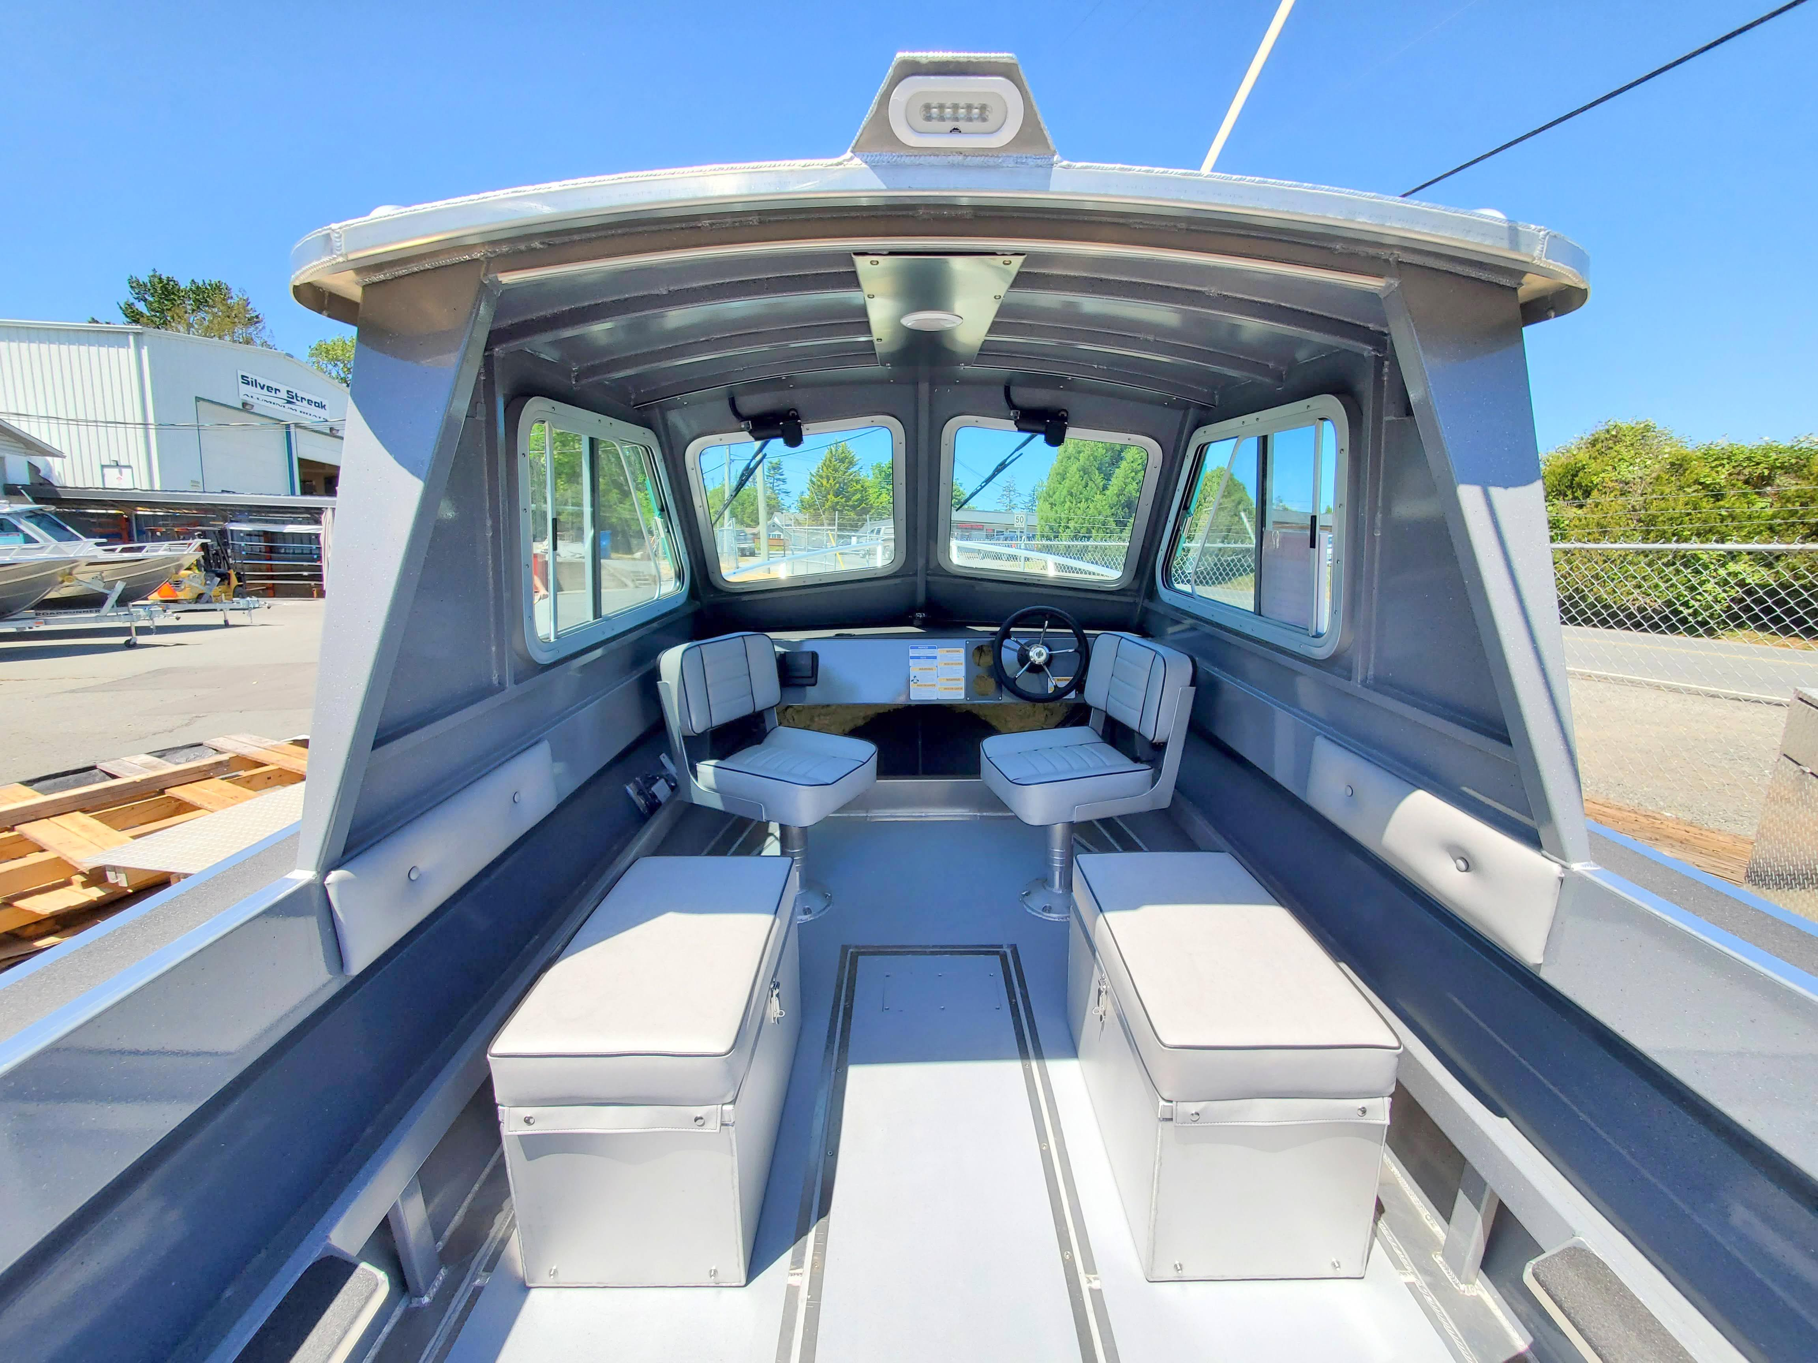
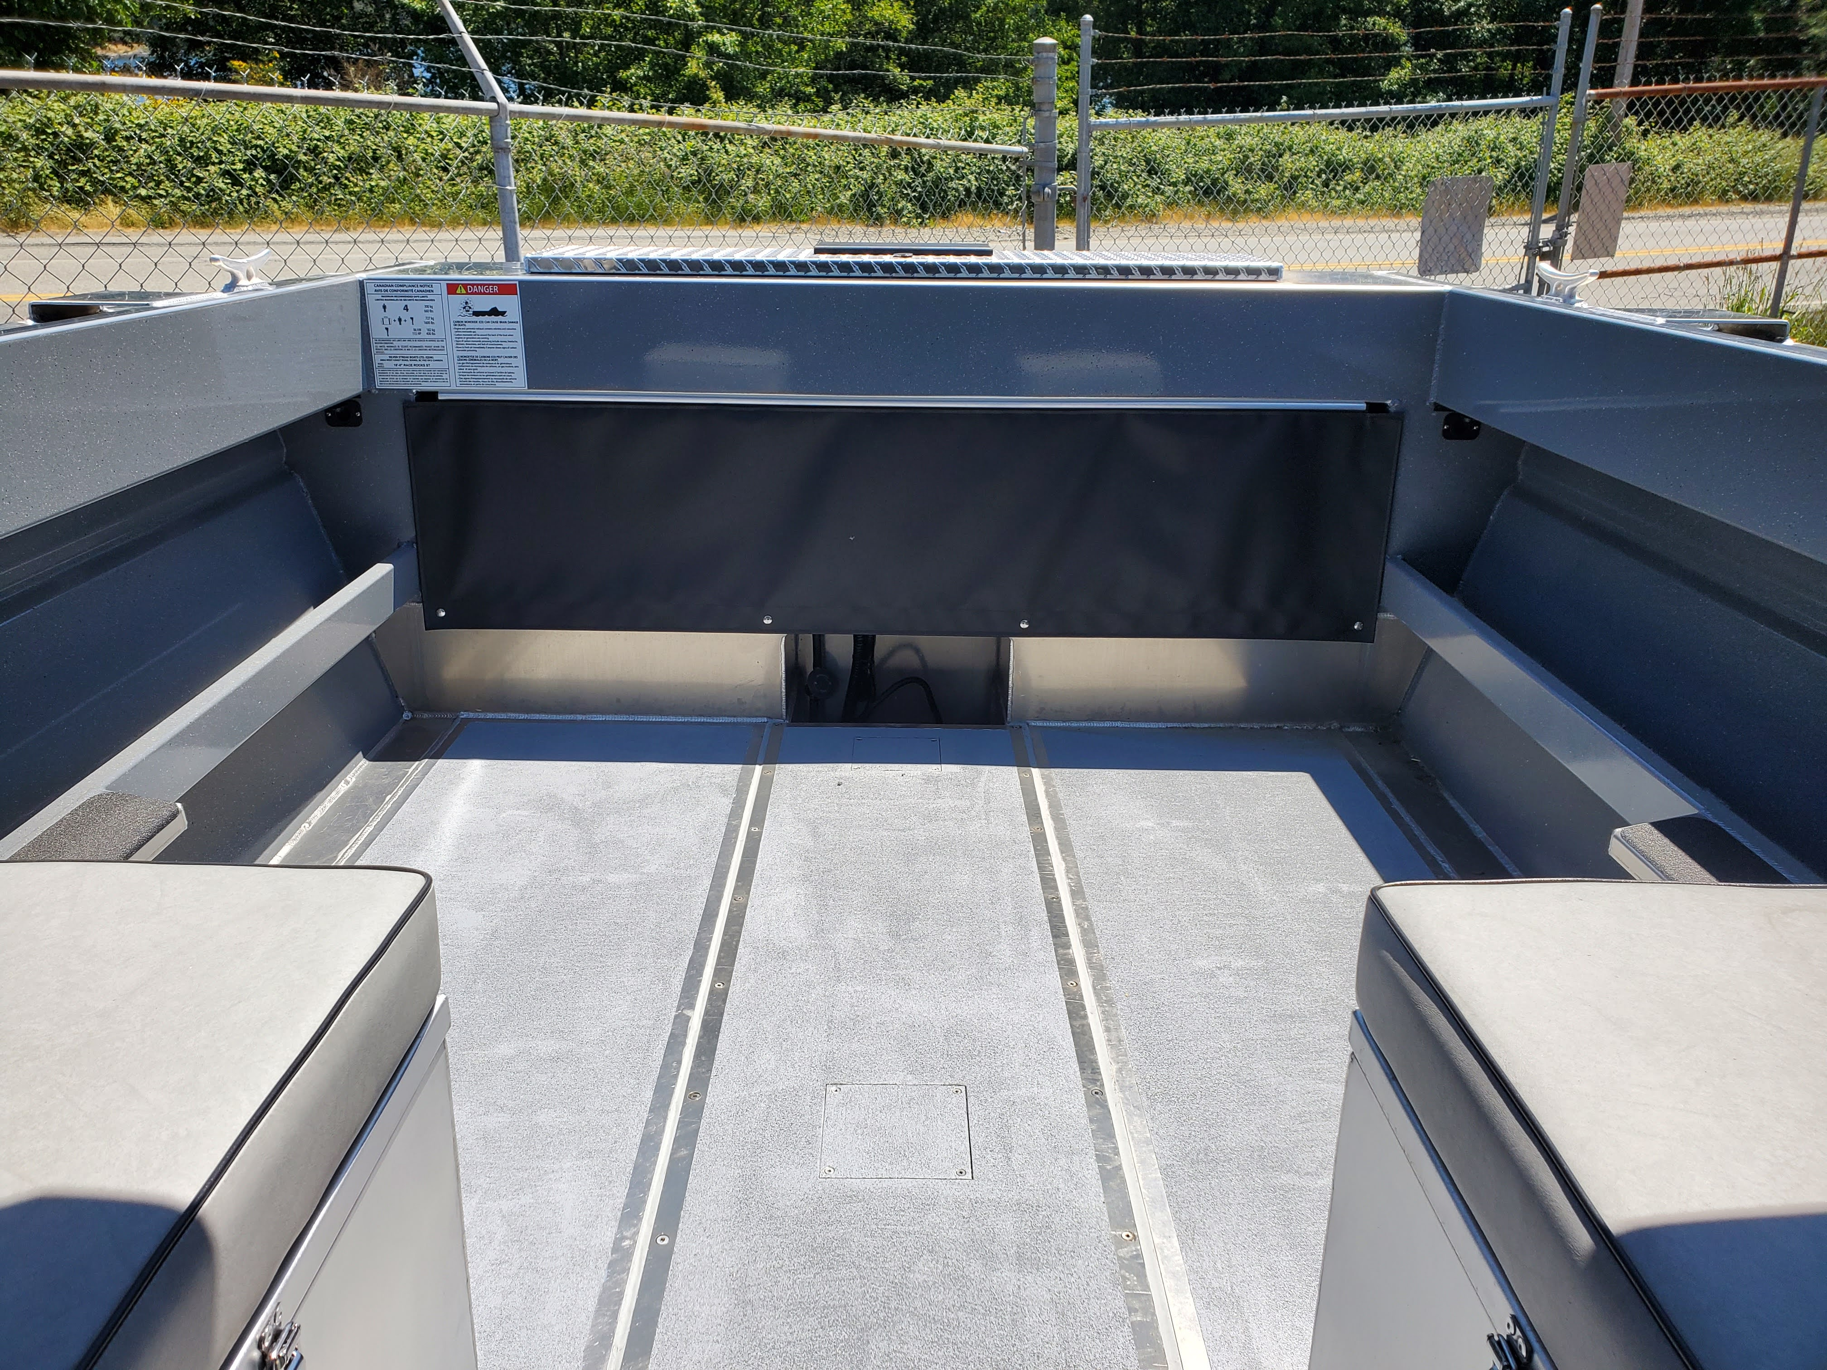
2023 18’-0” RACE ROCKS HARD TOP
CALL or EMAIL FOR PRICING
TEL: 250-642-5300 ext. 103
info@silverstreakboats.com
www.silverstreakboats.com
(OPEN MON-FRI 8:00 -4.30)

Slide 4
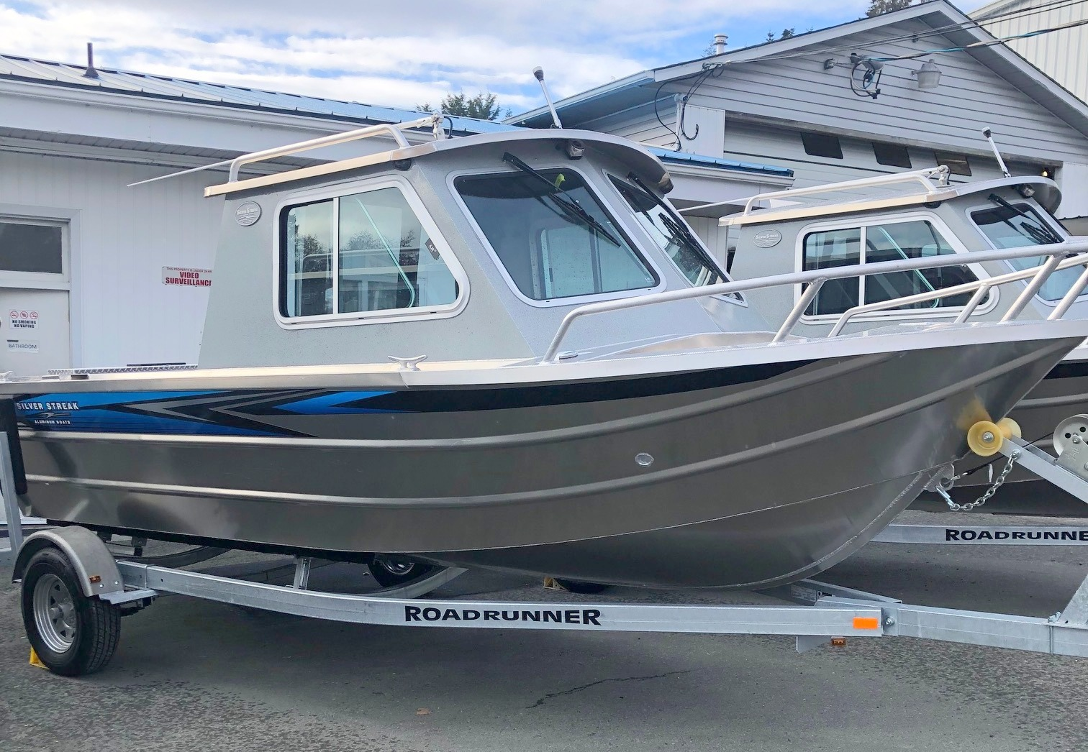
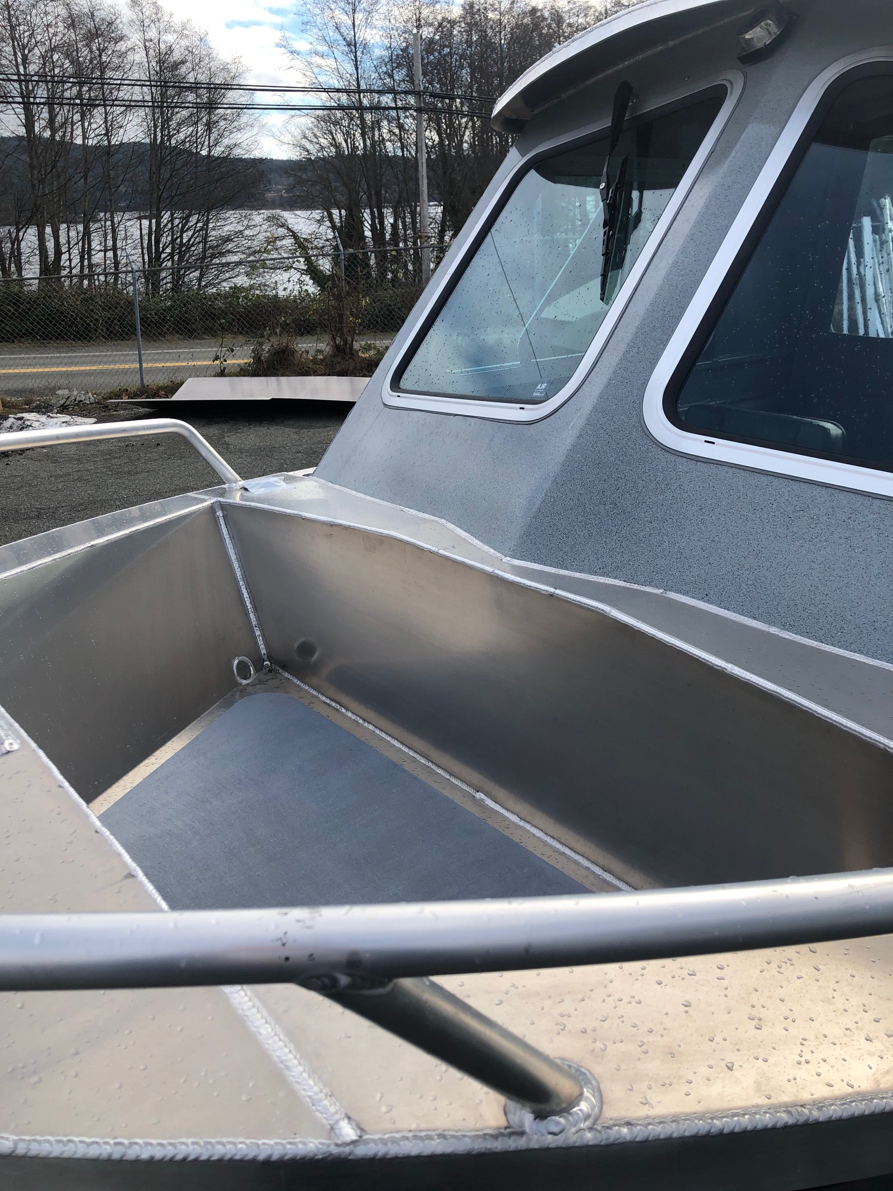
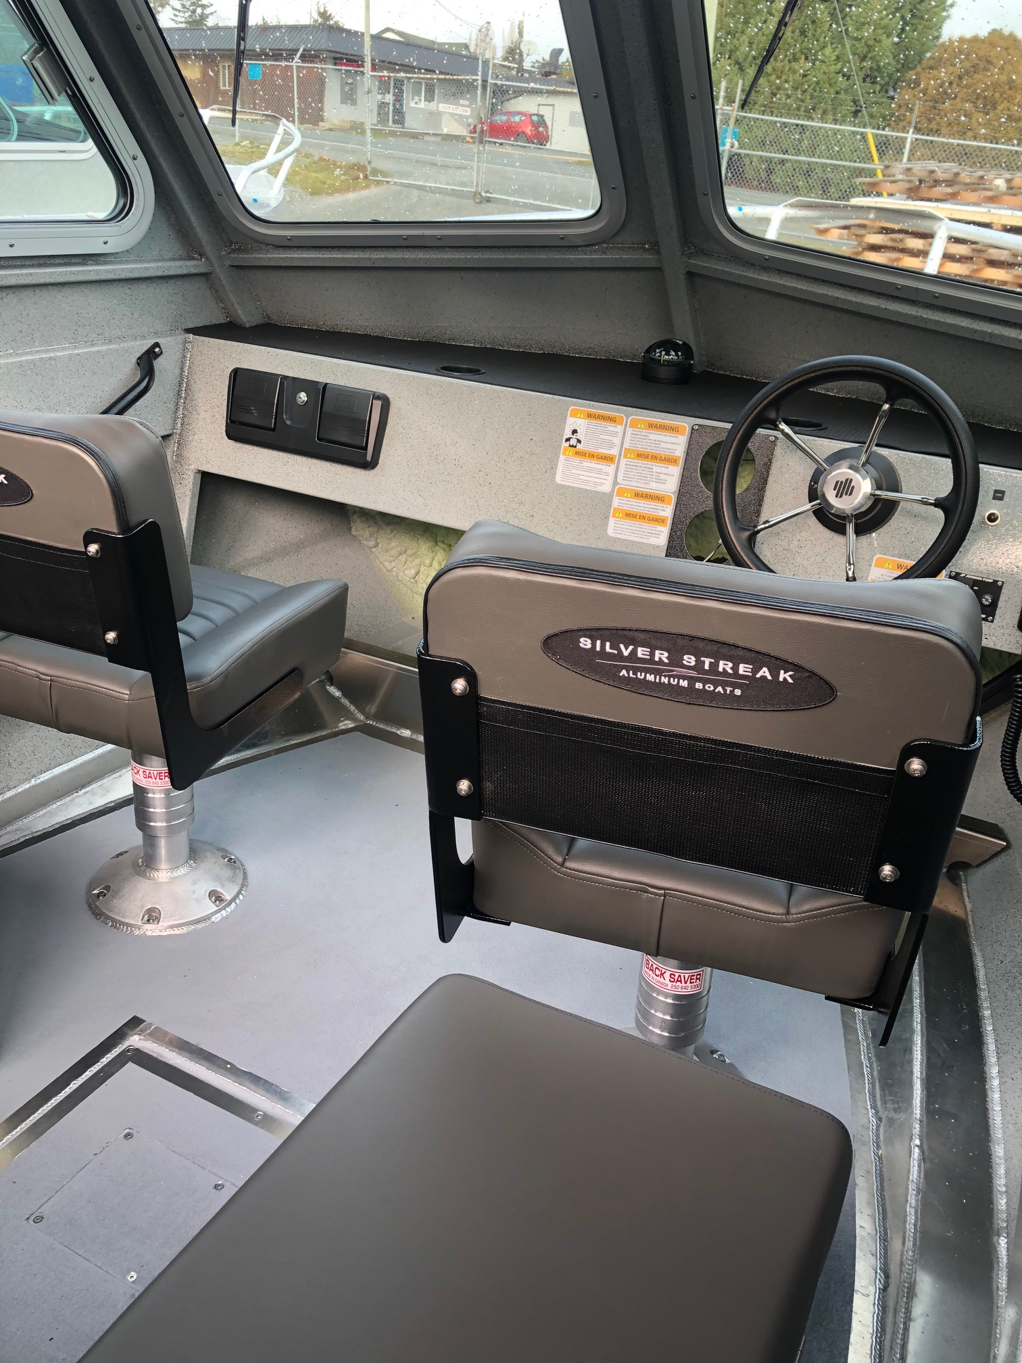
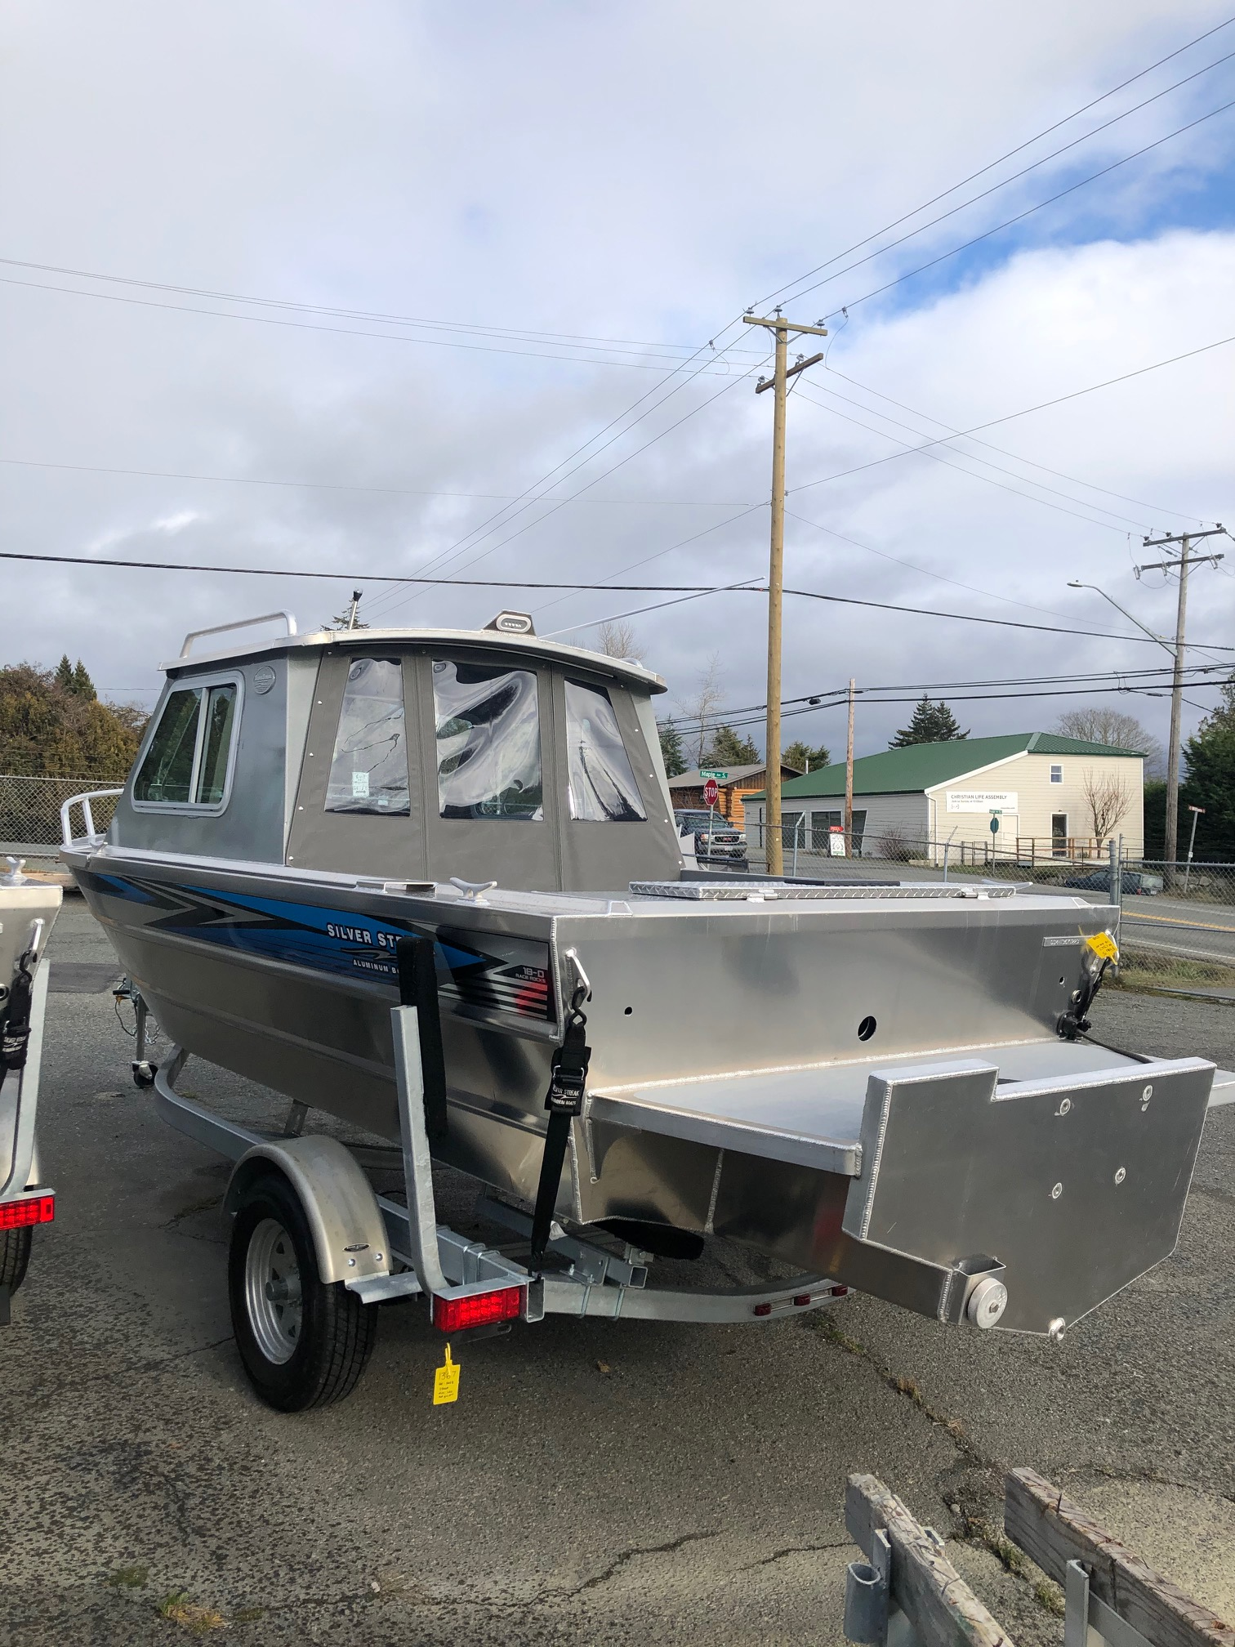
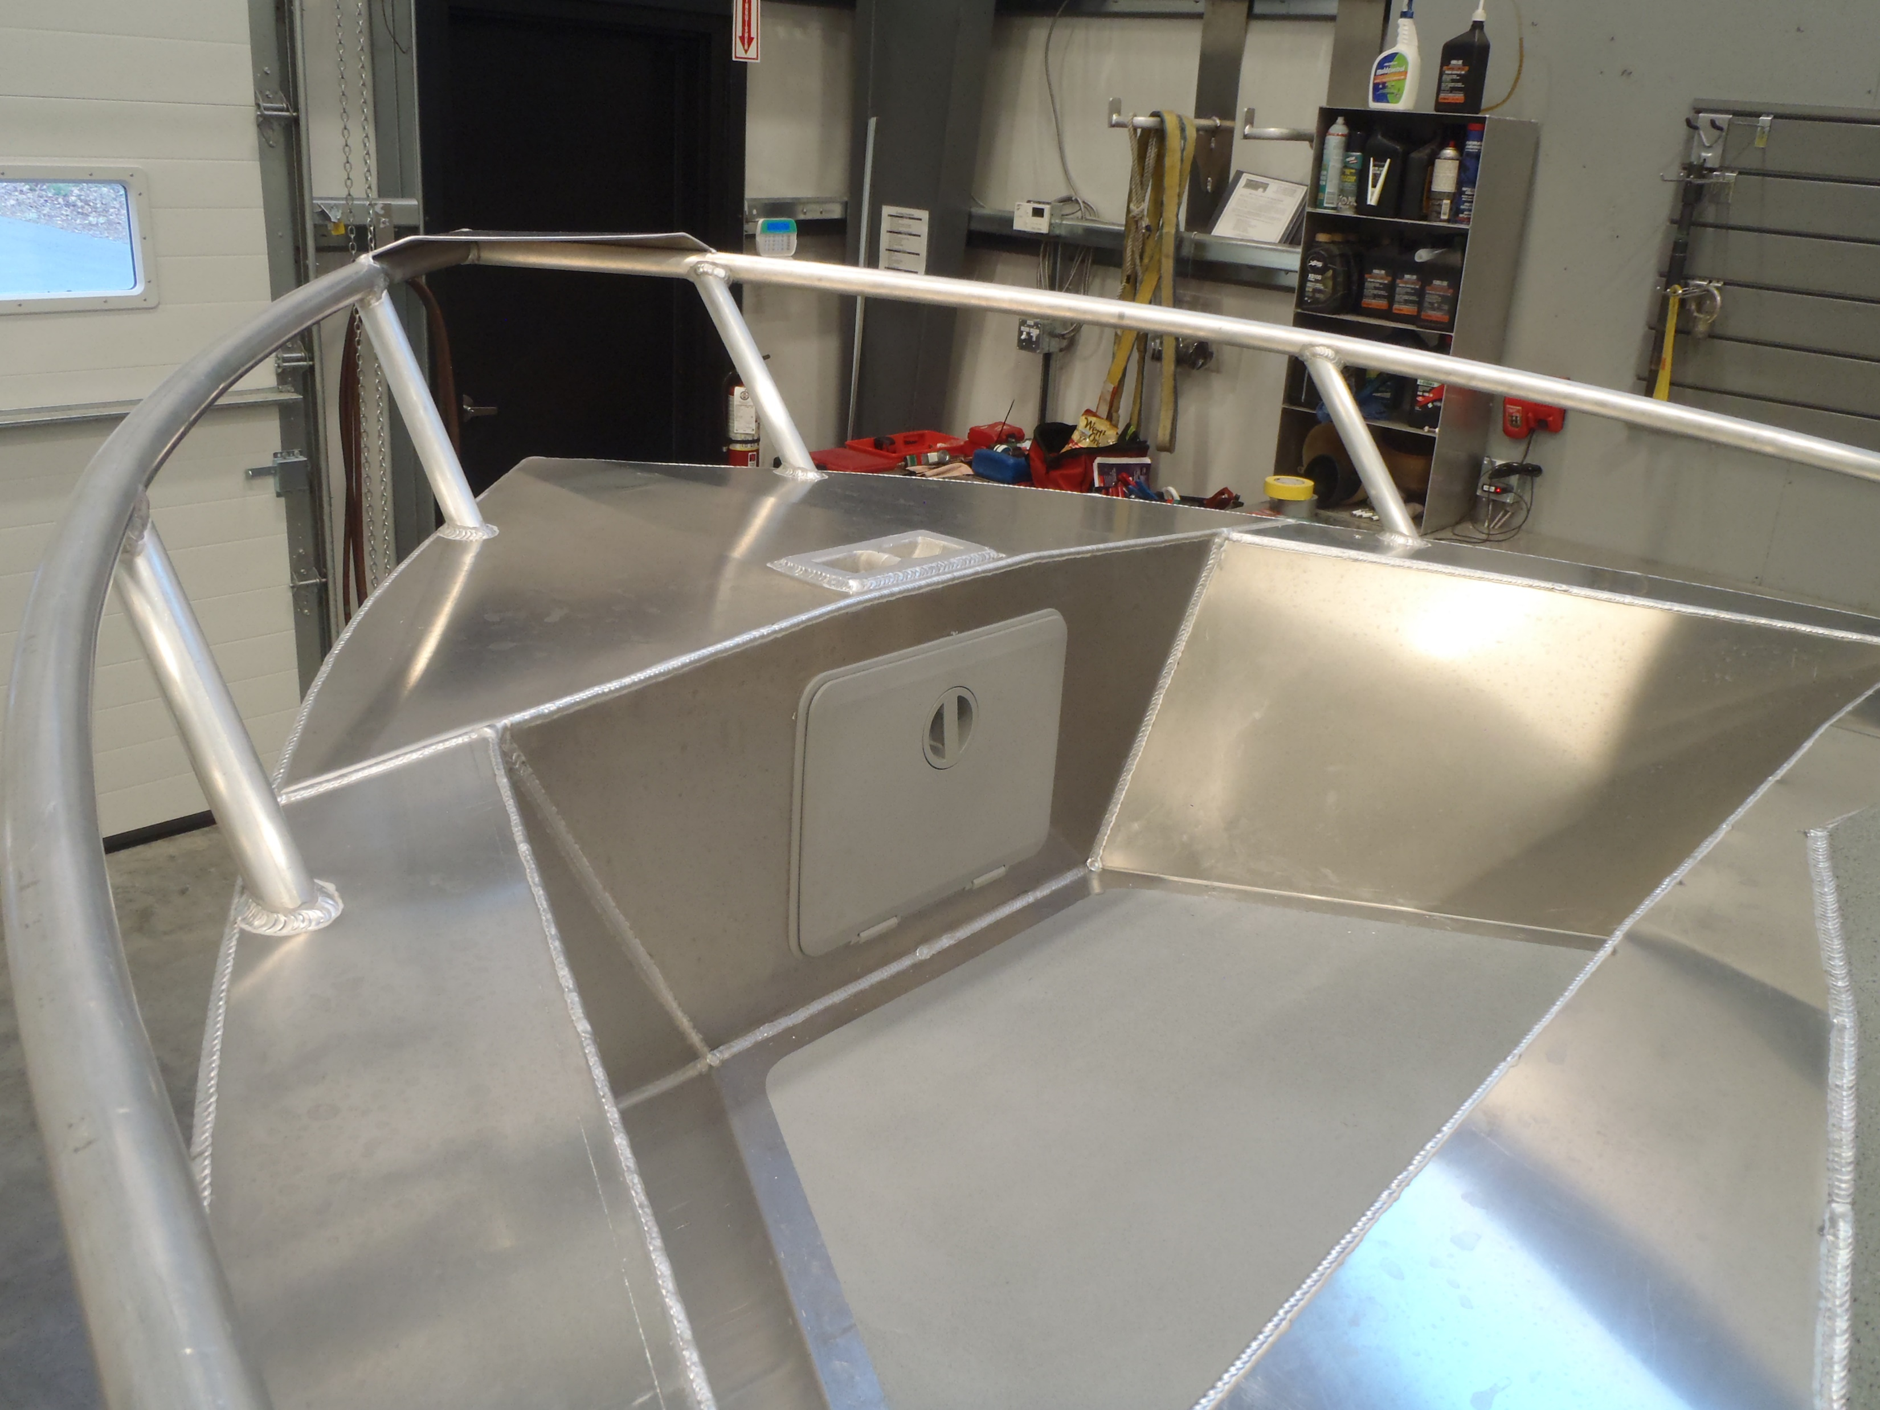
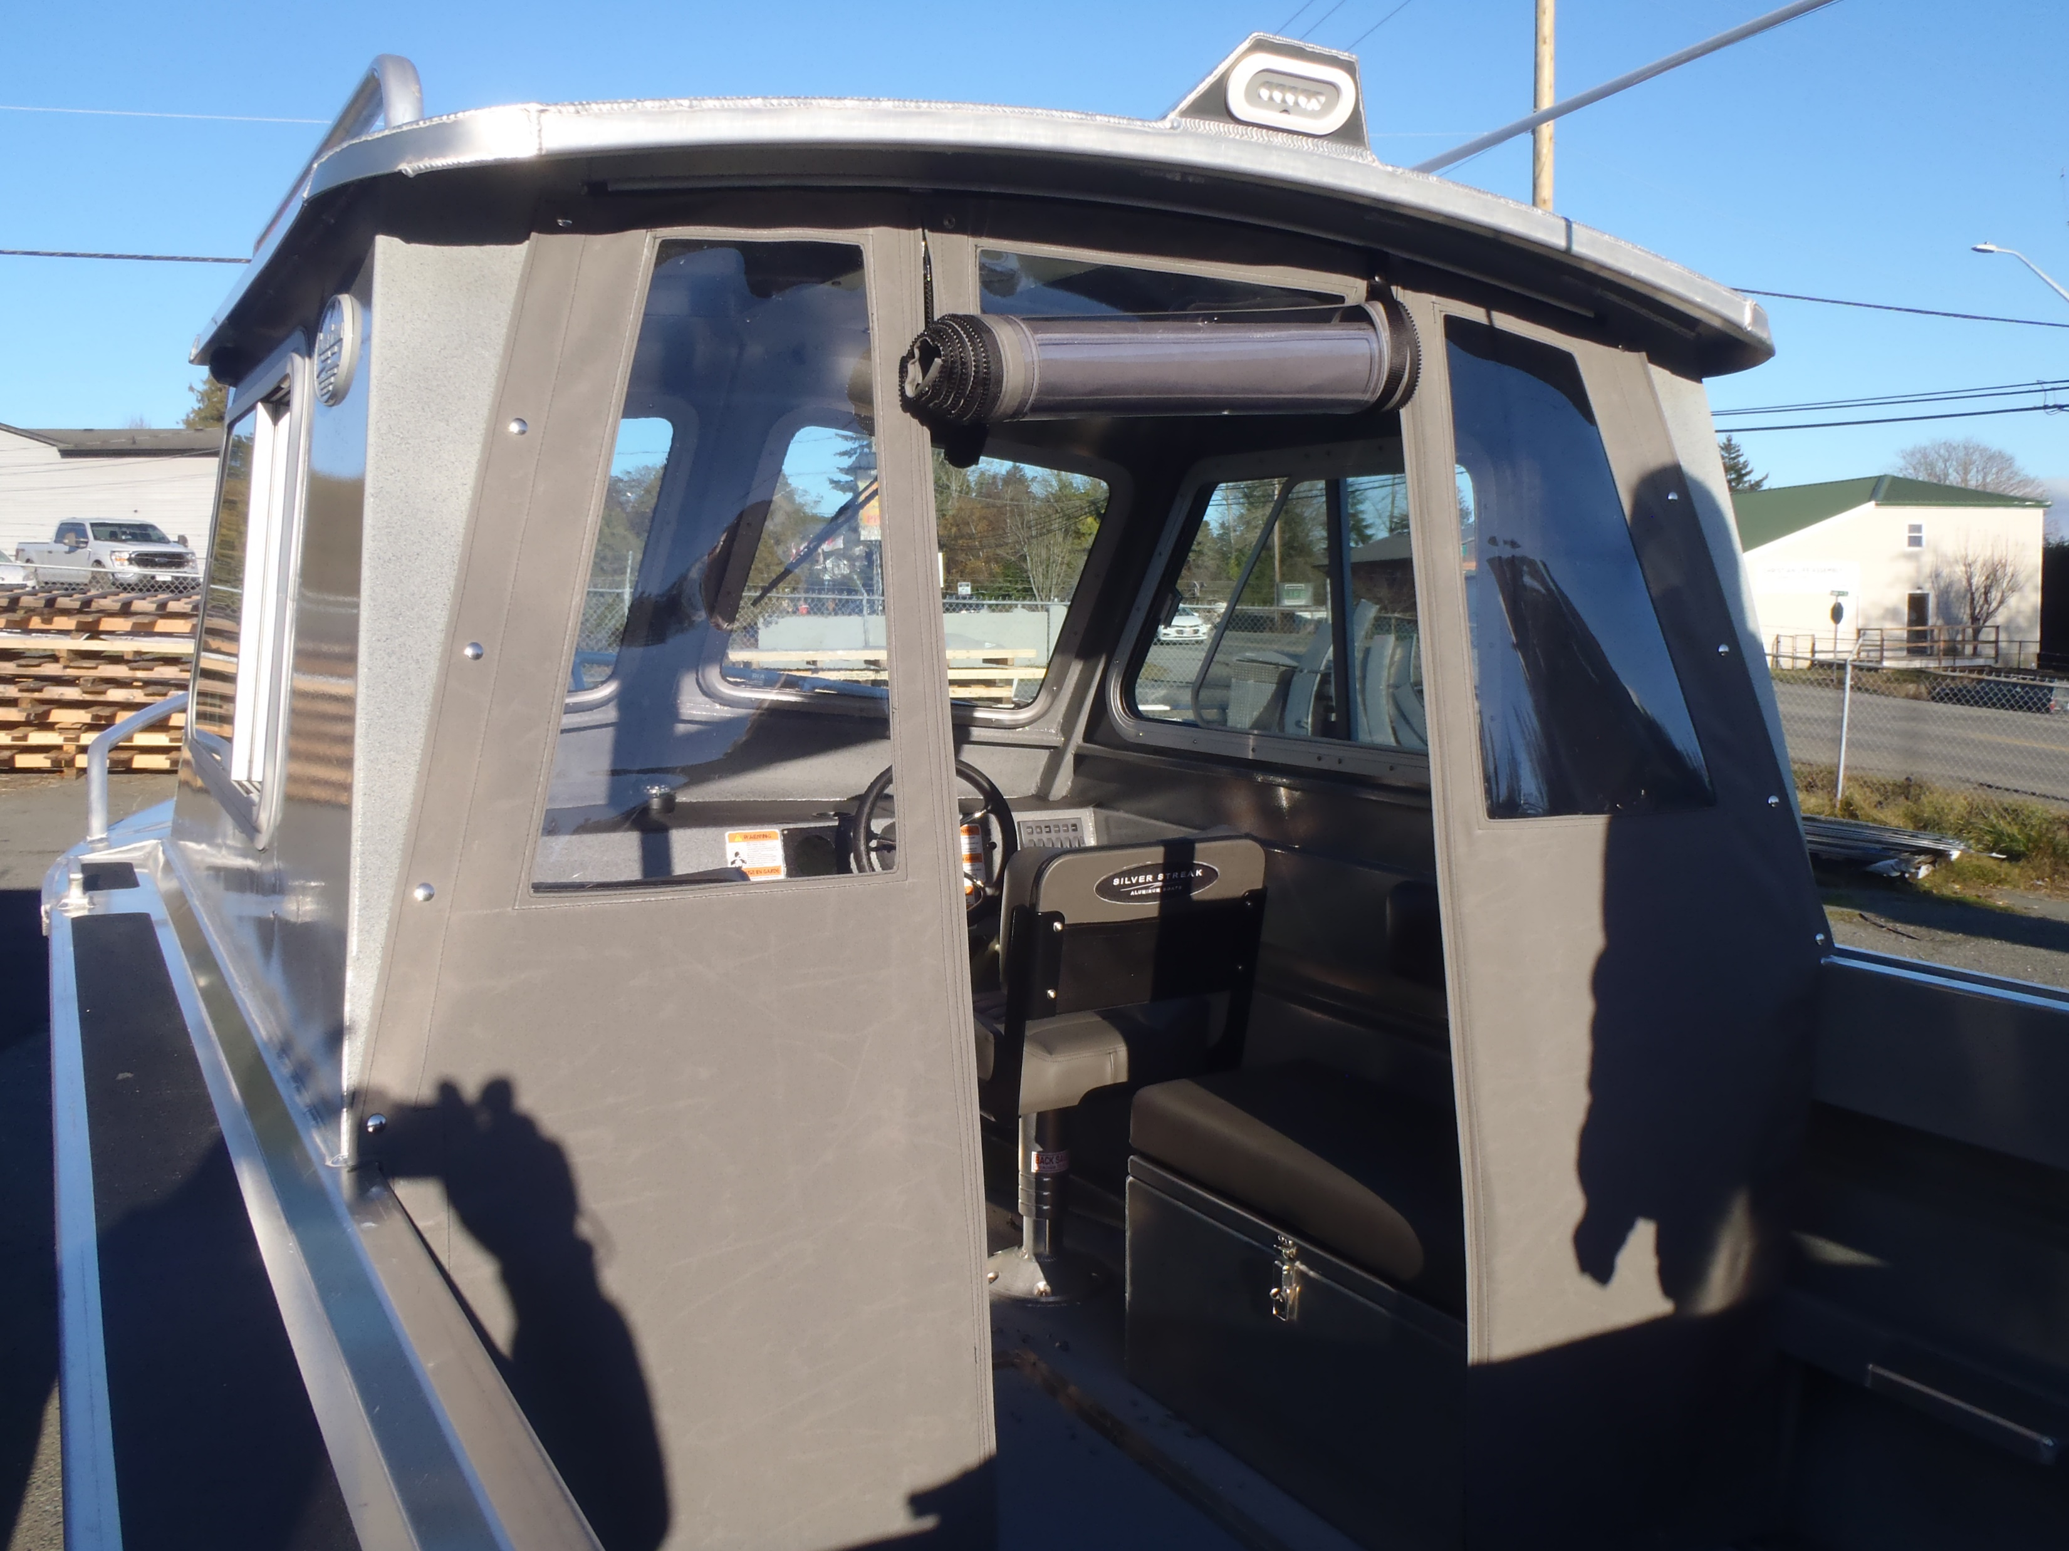
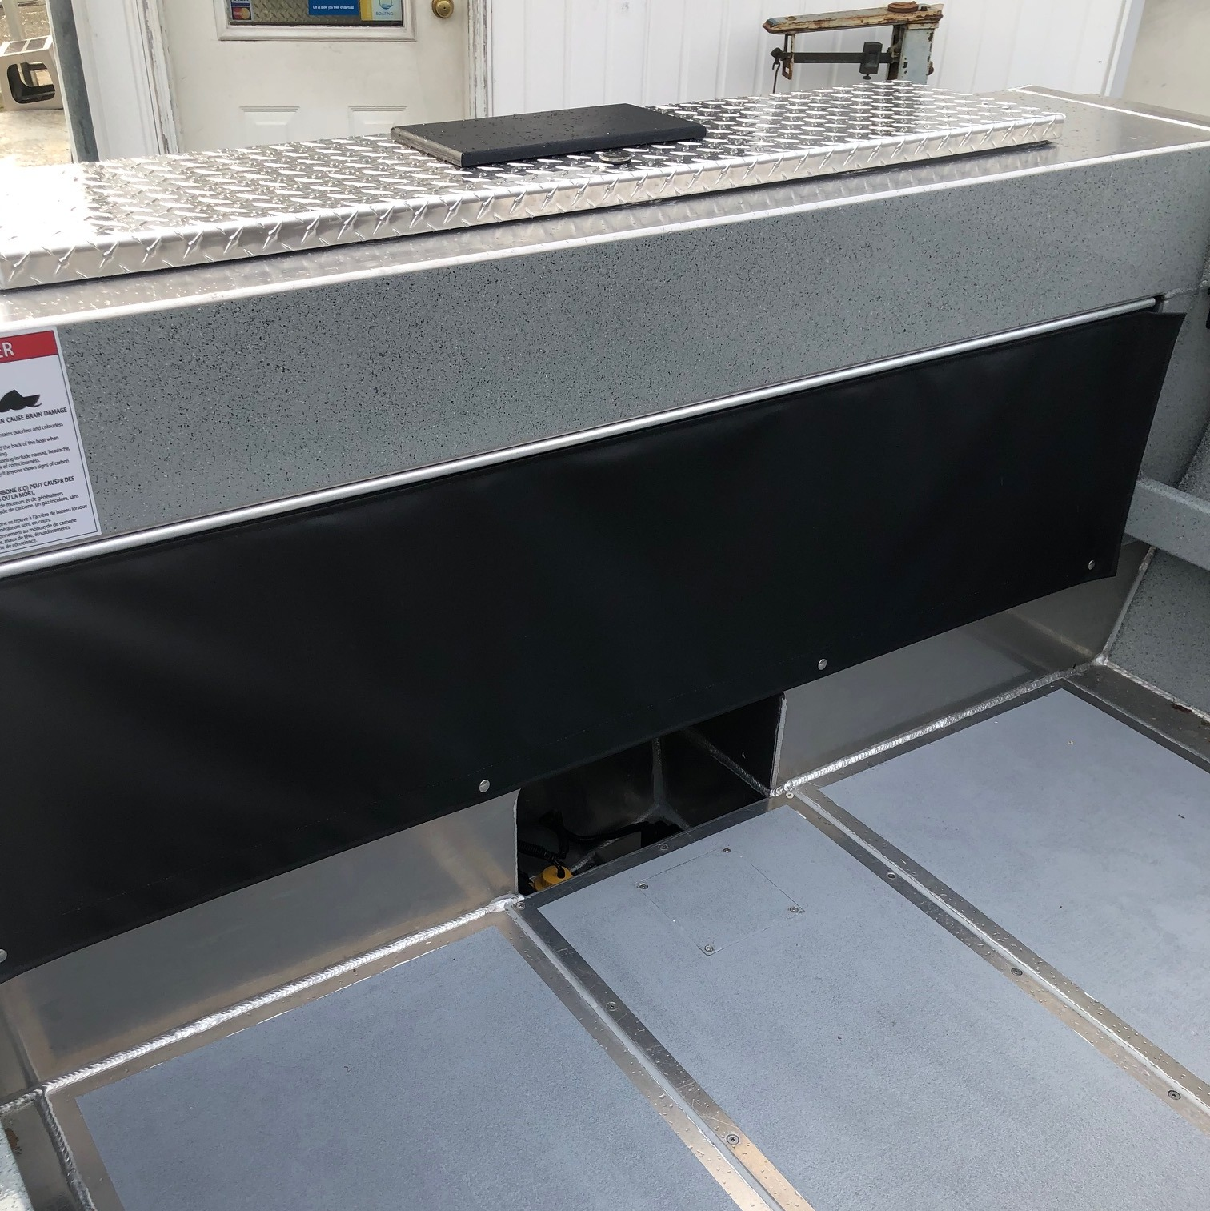
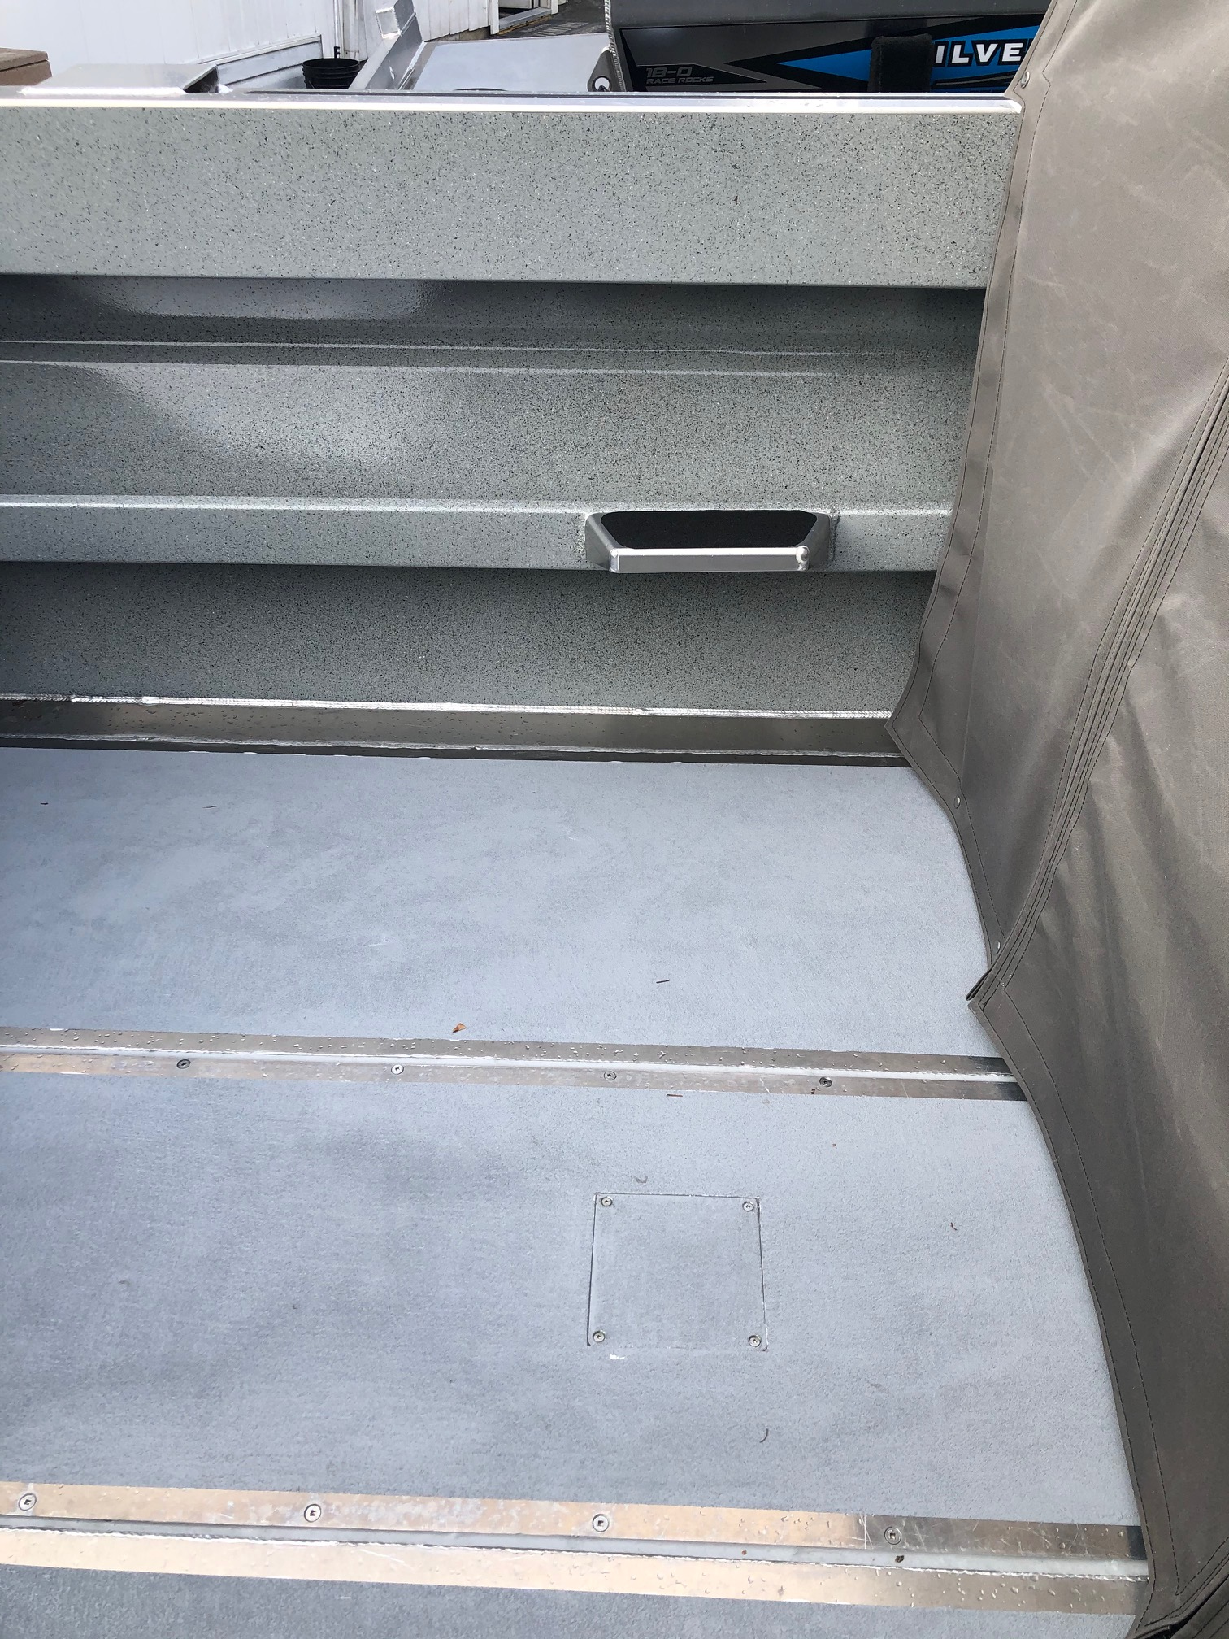
Different colour combinations for seats.
1368&1369 charcoal
1370 light grey with black piping swivel seats with black bench cushions
1372 light grey with black piping for seats and benches

